Slide 1
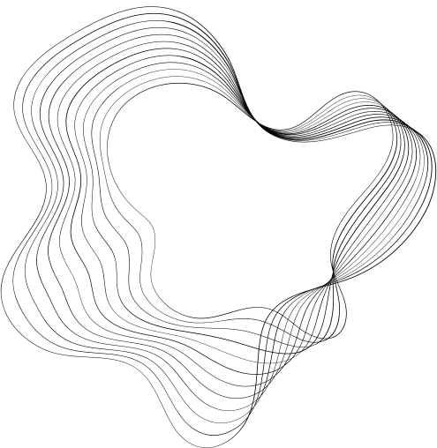



FITNESS COACHING
HACK-O-VERSE
PROJECT

Slide 2


CONTENT
01
OVERVIEW
02
MY PROPLEM STATEMENT
03
THE SOLUTION
04
IMPACT AND BENEFITS
05
MARKET AND OPPORTUINITY
06
TECHNOLOGY USED
07
TEAM SLIDE

Slide 3






OVERVIEW
TEAM NAME -- TECH WIZARDS
TEAM MEMBERS
KANISHKA SHARMA
JAI KUMAR
RISHAV SHAKYA

Slide 4



FITNESS COACHING APP
CALORIE CALCULATOR
BMI CALCULATOR
BMR CALCULATOR
A BMR calculator is a tool that estimates your Basal Metabolic Rate based on these factors. It helps you understand how many calories your body burns at rest, which is useful for determining your daily calorie needs for weight maintenance, loss, or gain.
A calorie calculator is a tool used to estimate the number of calories an individual needs to consume each day to maintain, lose, or gain weight. It takes into account various factors such as age, gender, weight, height, activity level, and weight goals.
A BMI (Body Mass Index) calculator is a tool used to assess an individual's body composition based on their weight and height. It's a simple calculation that provides an estimate of body fatness and helps categorize individuals into different weight status categories.

Slide 5


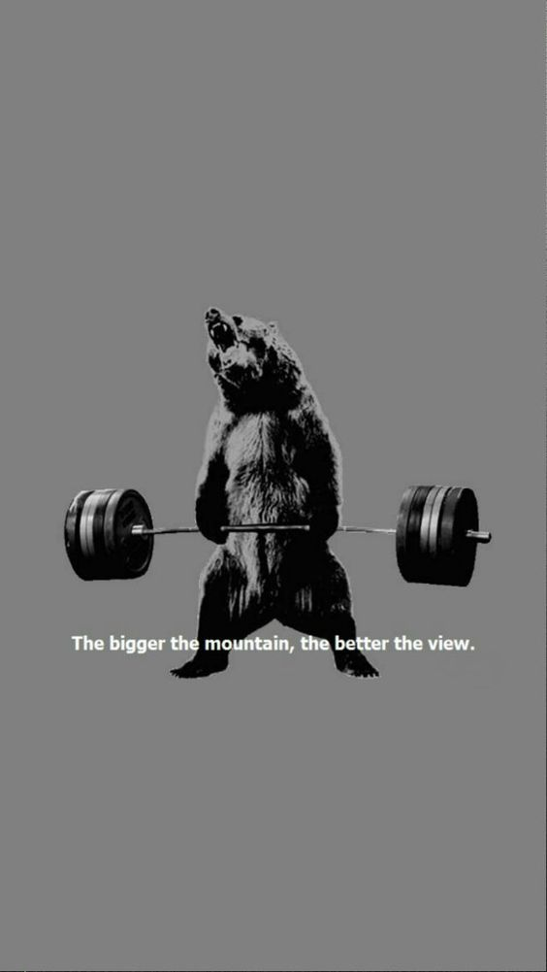


CONCEPT IN BUSINESS
Personalized Workout Plans: Fitness App utilizes an algorithm that takes into account users' fitness goals, current fitness levels, available equipment, and preferred workout styles to generate customized workout plans.
Exercise Library: The app offers a vast library of exercises with detailed instructions, images, and videos to ensure users perform each exercise correctly and safely.
Progress Tracking: Fitness App allows users to track their progress over time by recording various metrics such as weight, body measurements, workout duration, and intensity.
.
Goal Setting and Reminders: Users can set specific fitness goals and receive reminders to stay on track, helping them stay motivated and committed to their fitness journey.
CUSTOMERS

Slide 6
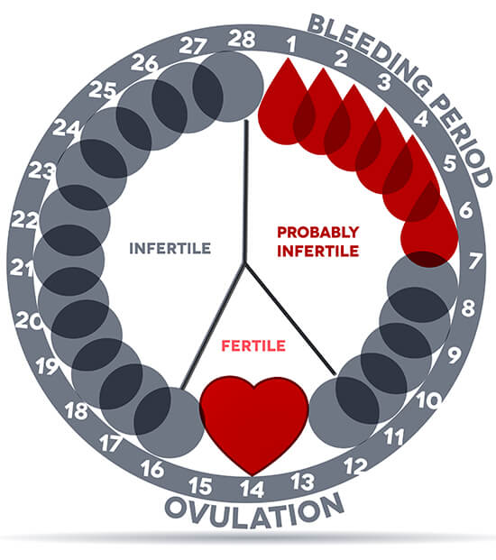
ON THE RAG
Menstruation, or period, is normal vaginal bleeding that occurs as part of a woman's monthly cycle.The website allows to maintain the period calendar. It will also notify the successive menstrual week.The app provides period relief exercises with proper instruction in the form of detailed images and videos,also tell about the food preferences to prevent period cramps.According to the intensity of pain it provides the appropriate exercise with suitable period of time.

Slide 7



TECHNOLOGY USED
01
02
03
04
HTML
CSS
JAVASCRIPT
HTML TAGS & CSS SELECTORS
It provides the structure and content of a webpage, defining elements such as text, images, links, forms, and multimedia.
It is used in web development to control the presentation and styling of HTML elements on a web page.
JavaScript is a powerful language that runs in the browser, enabling developers to create dynamic and interactive web experiences.
HTML tags are used to structure the content of a web page .We refer to selectors, properties, and values rather than tags. CSS is used to style the appearance of HTML elements.

Slide 8




OUR TEAM
RISHAV SHAKYA
JAI
KUMAR
KANISHKA SHARMA
TECH WIZARDS
TECH WIZARDS
TECH WIZARDS

